Slide 1

VIDEO
GAME ANALYSIS
EXCEL ANALYSIS
Amit Singh Sansoya
11615144

Slide 2
Performing analysis on the dataset for finding the top video games and analyzing them according to the genre, publications and sales.
— Amit Singh Sansoya

Slide 3
INTRODUCTION
OBJECTIVE
Lets discuss my top objectives
What are my objectives?
Studying various type of platform on which games are played
Studying various types of famous genres and considering it as major factor to define popularity of games
Comparing sales of games after categorizing them in genre and publication wise
Trying to predict the future and its sales for the upcoming years
Analysis on the basis of the Publications

Slide 4
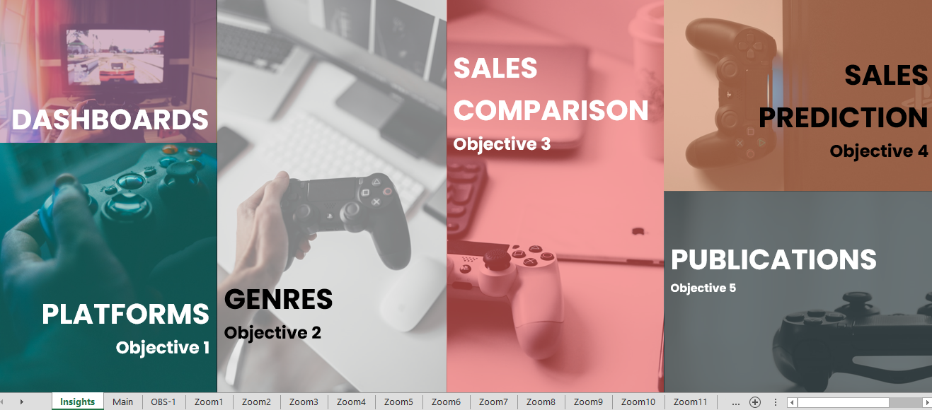
Menu

Slide 5
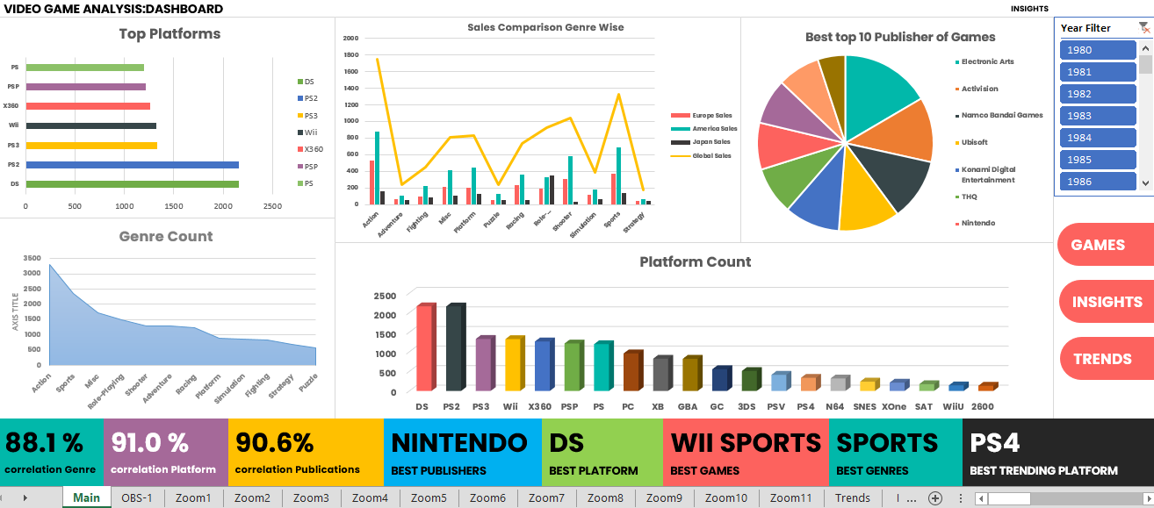
Dashboard

Slide 6
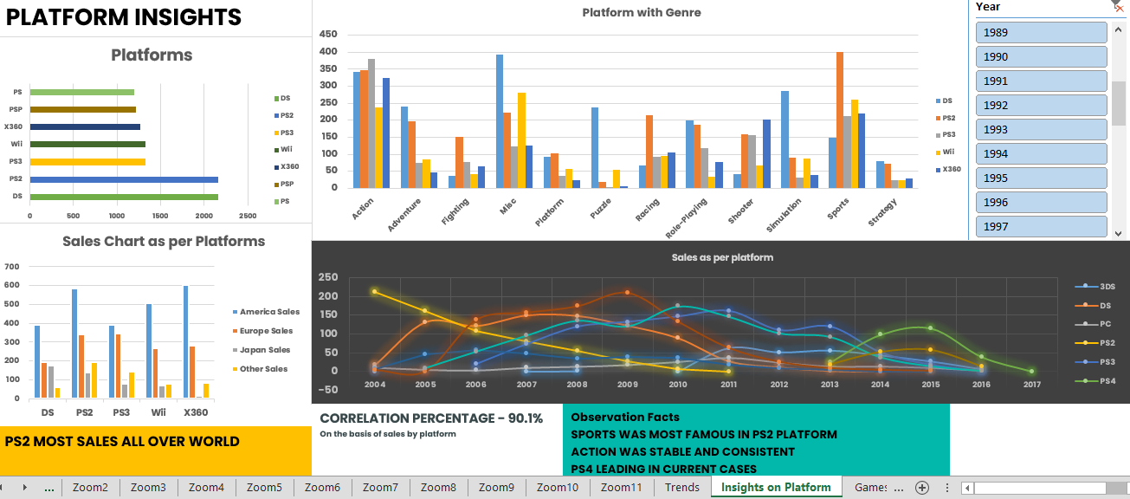
Platform
Objective 1

Slide 7
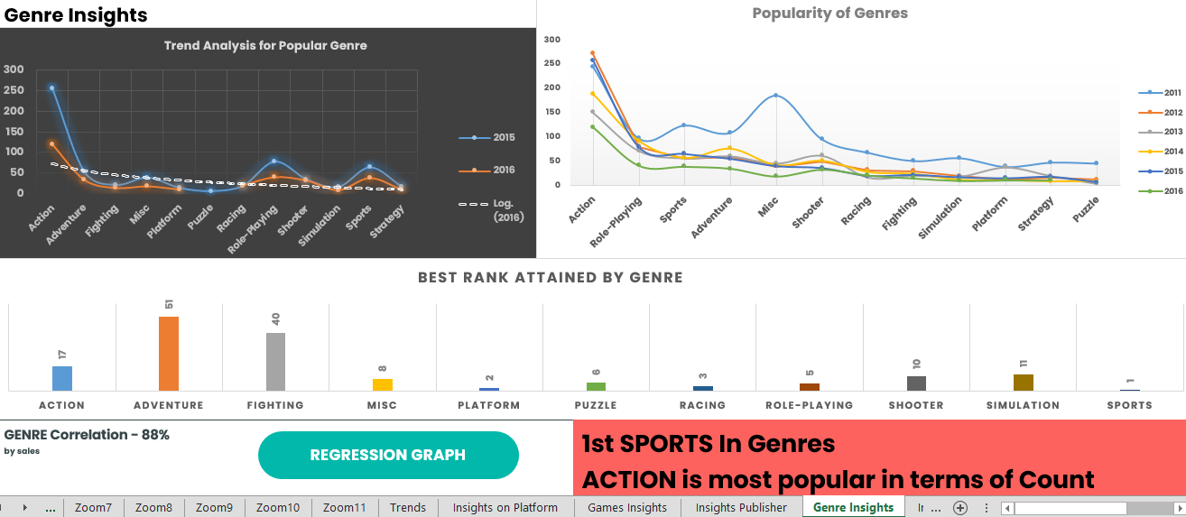
Genres
Objective 2

Slide 8
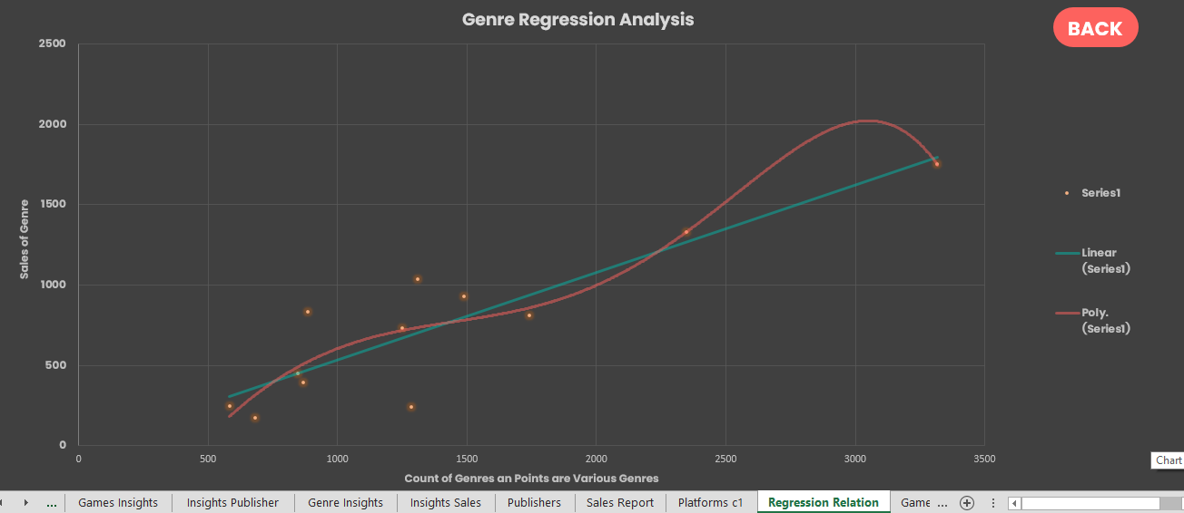
Objective 2
Regression Graph

Slide 9
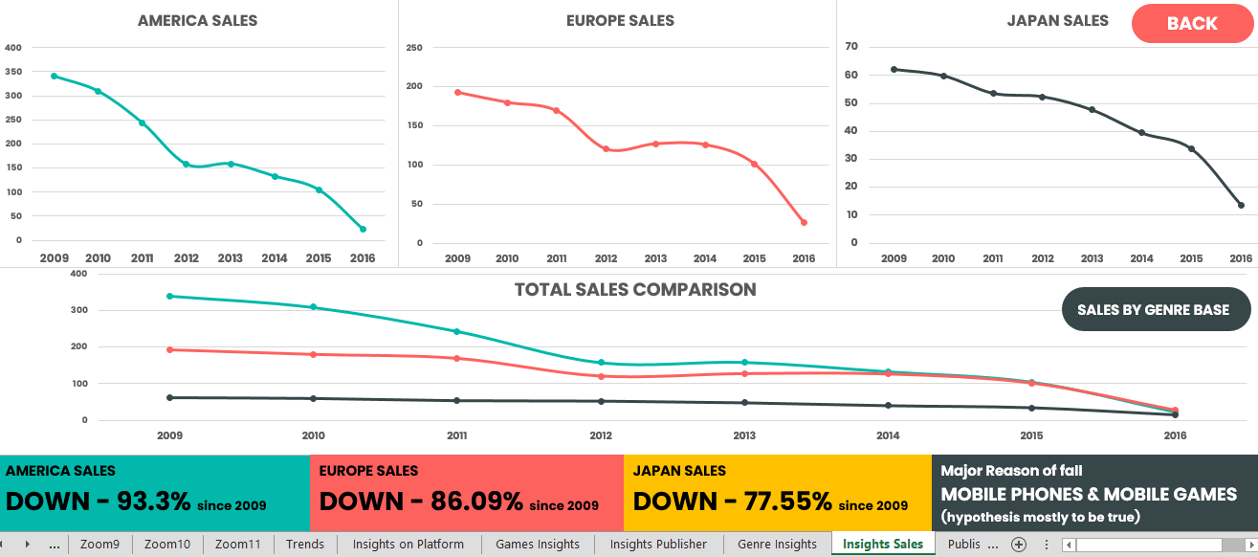
Sales
Objective 3

Slide 10
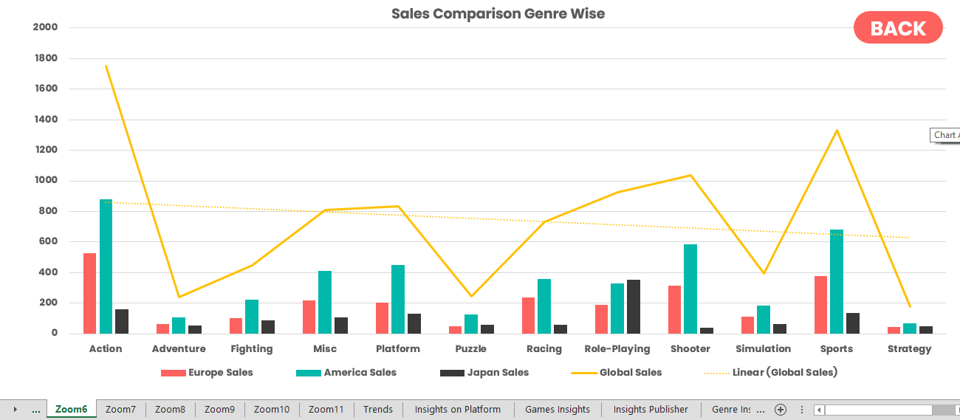
Objective 3
Sales Graph

Slide 11
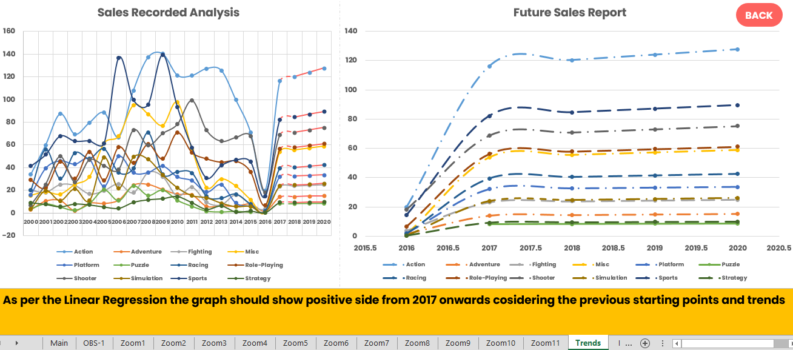
Future
Objective 4

Slide 12
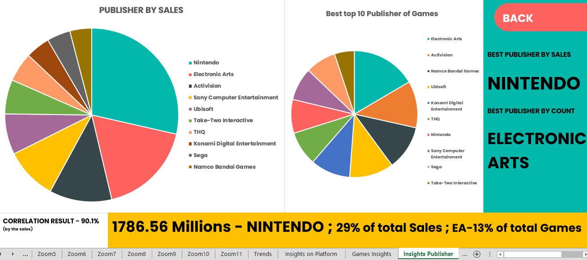
Publication
Objective 5

Slide 13
THANK YOU
Presentation and Analysis by:
AMIT SINGH SANSOYA
11615144

